Slide 1

The Water Paradox: Abundance and Scarcity
Earth is mostly water, but usable freshwater is scarce.
Water is renewable, yet scarcity affects billions.
Water brings life, but also destruction like floods.

Slide 2
Beyond Droughts: Real Reasons for Water Scarcity
Over-exploitation
Thirsty Agriculture
Industrial & Urban Thirst
Excessive use by growing populations.
Largest water consumer, especially in dry seasons.
Rapid growth strains freshwater resources.

Slide 3
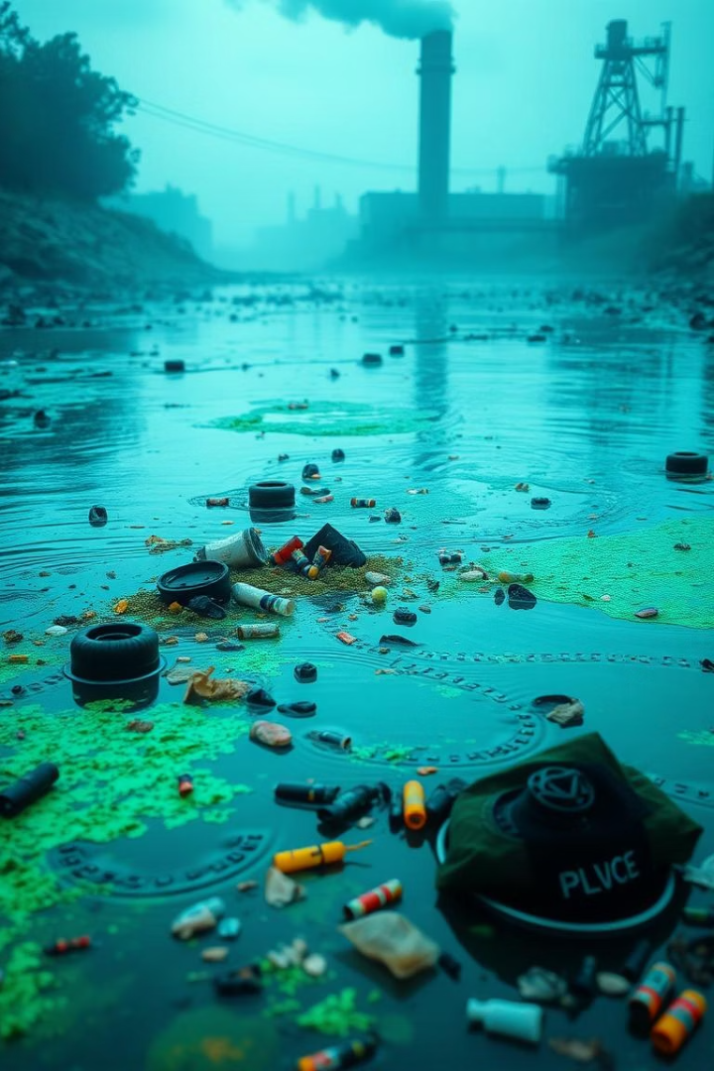
Hidden Scarcity: The Impact of Pollution
Unusable Water
Pollution makes water hazardous.
Domestic & Industrial Waste
Major sources of contamination.
Chemicals & Pesticides
Agricultural runoff pollutes water.

Slide 4




Dams: "Temples" or Troubled Waters?
Electricity
Water Supply
Flood Control
Power generation.
Homes and industries.
Mitigating disasters.

Slide 5
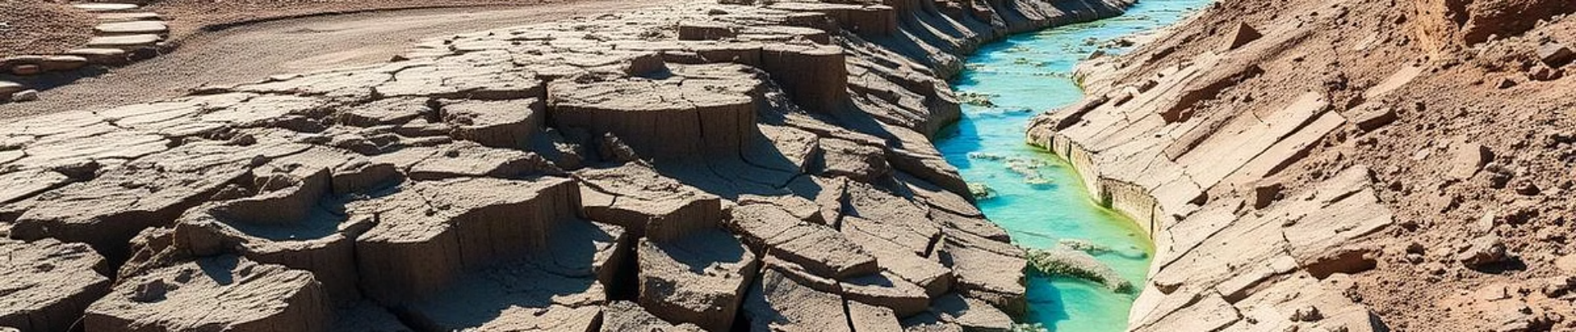
Dams: Environmental & Social Concerns
Environmental Impact
Accidental Floods
Ecological Crisis
Disrupts river flow, harms aquatic life.
Sedimentation can trigger floods.
Linked to earthquakes, diseases, pests.

Slide 6
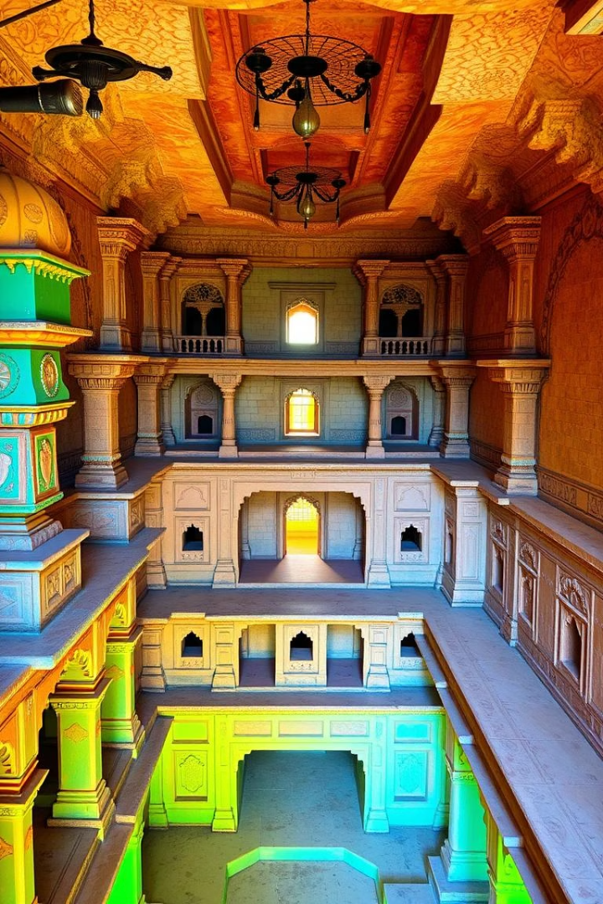
Ancient Wisdom: Rainwater Harvesting
1
Himalayan Guls/Kuls
Diversion channels for agriculture.
2
Rajasthan Khadins/Johads
Rain-fed storage for soil soaking.
3
Rajasthan Tankas
Underground tanks for drinking water.

Slide 7
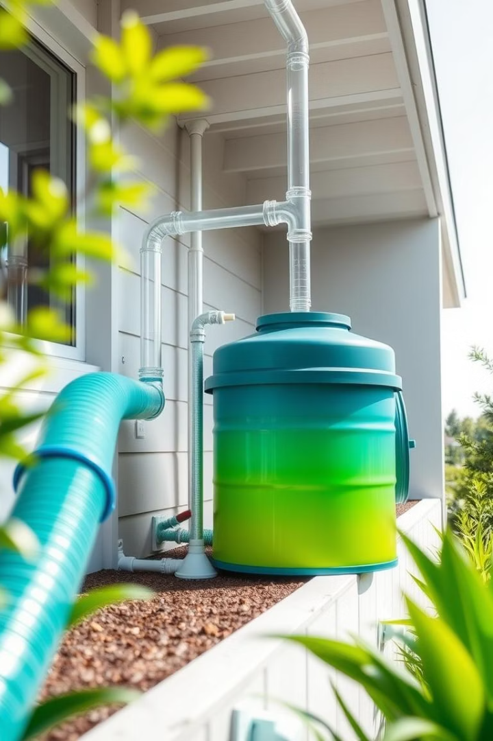



Modern Rainwater Harvesting Success
Tamil Nadu
Rooftop harvesting compulsory.
Shillong, Meghalaya
Relies on rooftop harvesting for 15-25% needs.
Gendathur, Mysuru
200 households collect 50,000 litres annually.

Slide 8



Conserving for Tomorrow: Government Initiatives
Jal Jeevan Mission
1
Piped water to rural homes.
Atal Bhujal Yojana
2
Behavioral change in water-stressed areas.
Pradhan Mantri Krishi Sinchayee Yojana
3
Efficient on-farm water use.

Slide 9



The Bamboo Drip System of Meghalaya
Ancient System
200-year-old technique.
Precise Delivery
20-80 drops per minute.
Efficient Irrigation
Water delivered directly to plants.

Slide 10




Water: A Shared Responsibility
Health
1
Food Security
Essential for well-being.
2
Crucial for agriculture.
Ecosystems
4
Livelihoods
3
Vital for natural balance.
Supports economic activities.

